Slide 1






A PROJECT
ON
WEB APPLICATION DEVELOPMENT
ISE 3 B
KHUSHI AGRAWAL
1BM20IS066
VIGNESH JR
1BM20IS181

Slide 2


COLLEGE ALLOCATOR
CONTENTS
AIM
OBJECTIVE
RESULT
CONCLUSION

Slide 3


AIM
Generally, after completing their PUC, most students are found in a state of dilemma about which college to choose. After having appeared for various competitive exams ,they eagerly wait for the counselling or college allotment process to begin.
Our website predicts colleges which a student might be allocated in advance based on his/her rank, which eases their decision making and helps them find a suitable college.

Slide 4

OBJECTIVE
We have created a website that helps students predict the college which is going to be allocated to them before the counselling starts on the basis of their ranks.
They are provided with a list of colleges and the specific branch which would be allocated to them most probably with maximum accuracy.
In case of any queries or help they can reach out to us at anytime. We have provided our contact details.

Slide 5
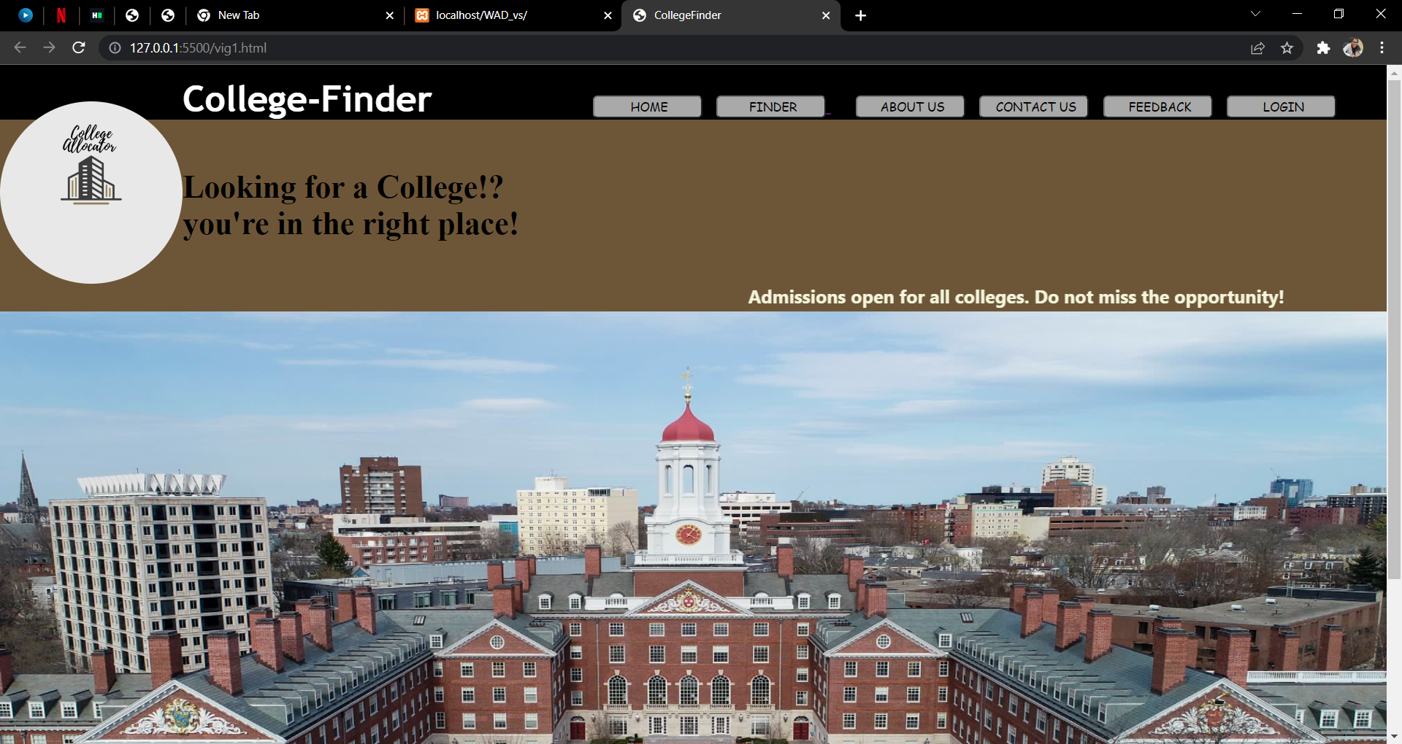
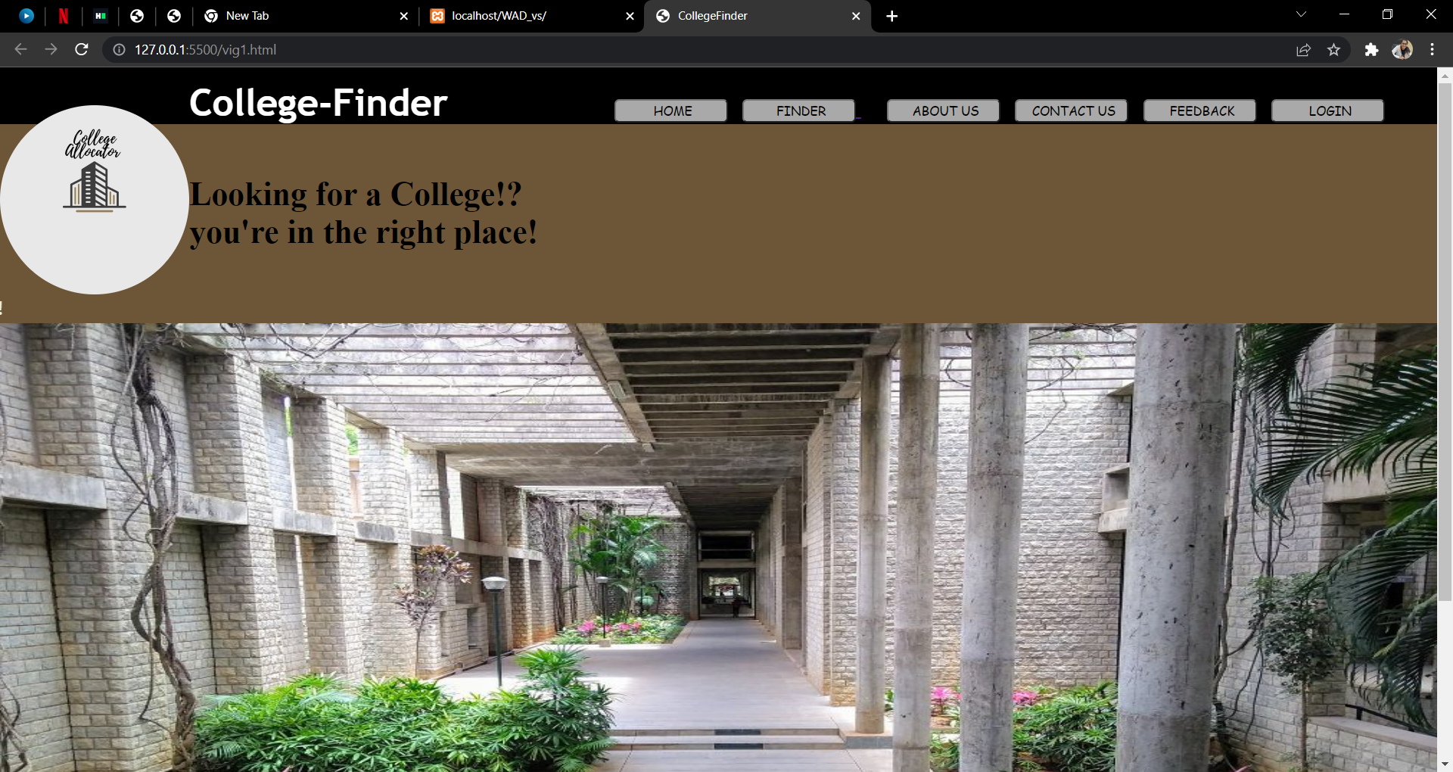
RESULT
Here are the snapshots of the results:

Slide 6
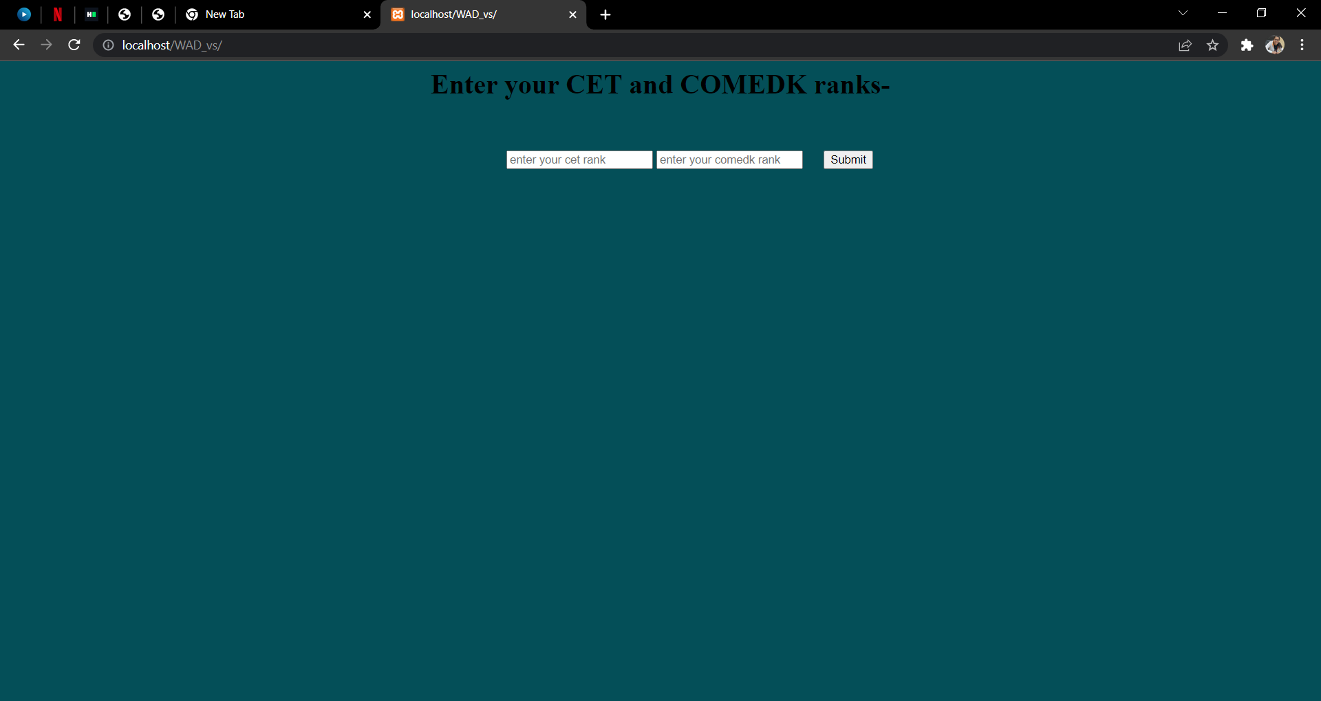
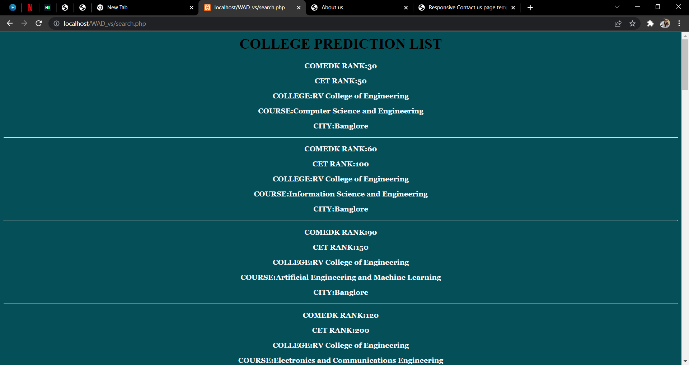

Slide 7
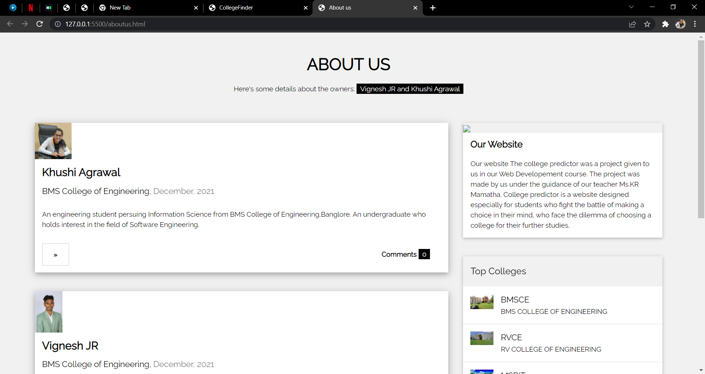
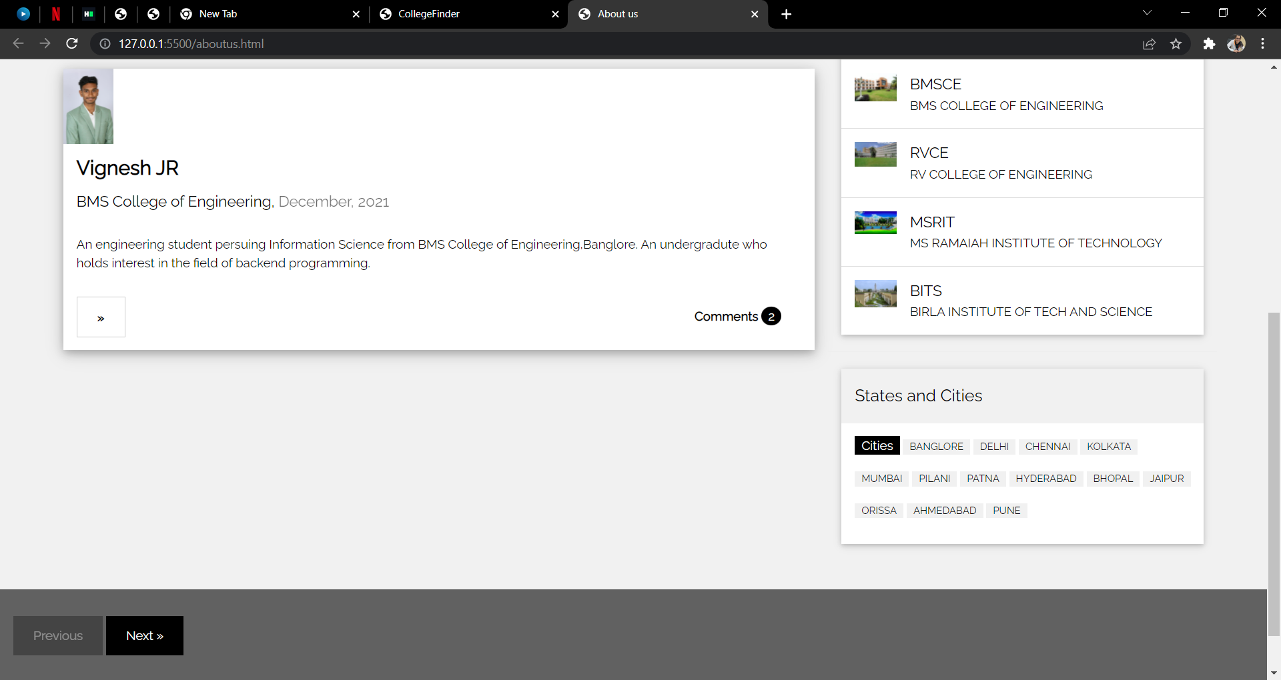

Slide 8
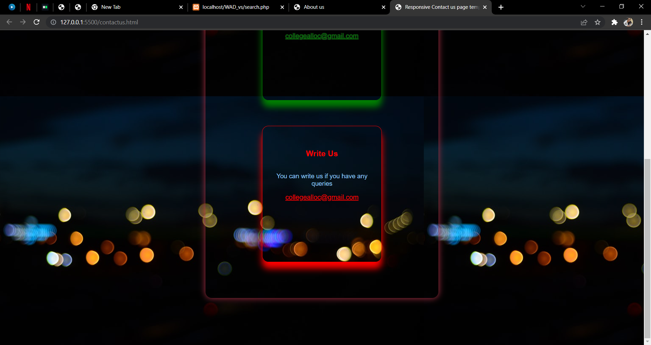
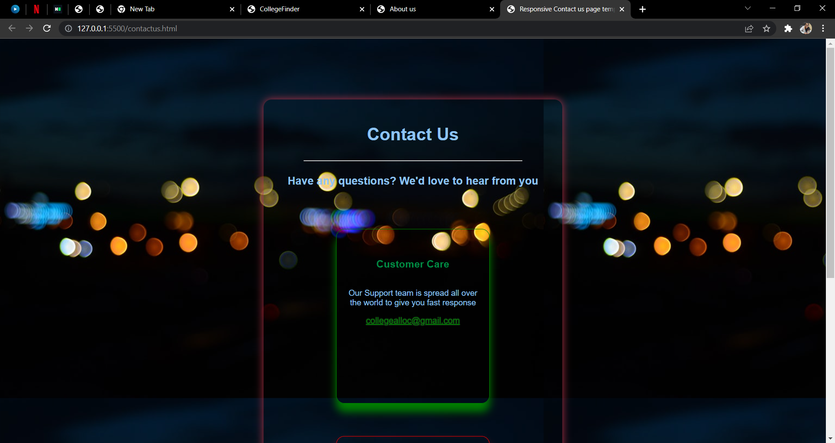

Slide 9
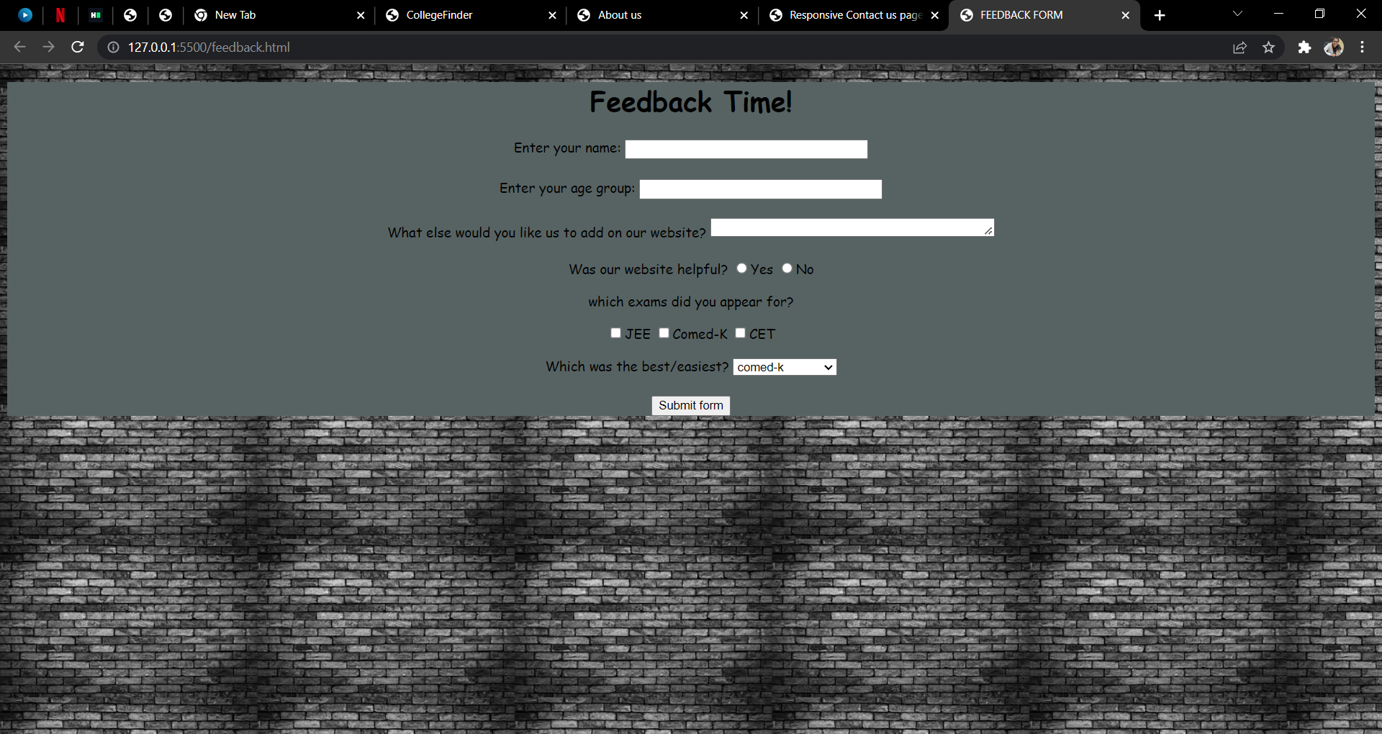

Slide 10
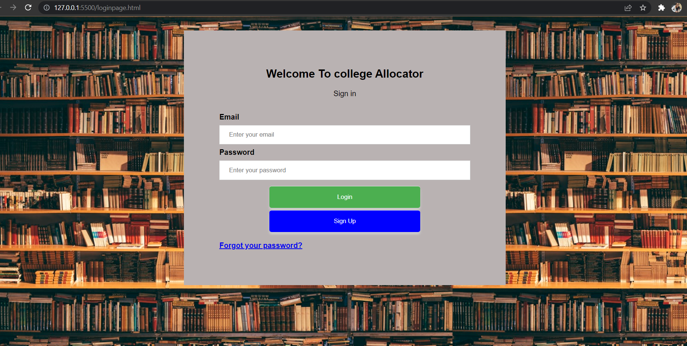

Slide 11
CONCLUSION
Programing Languages:-
➢ HTML (HyperText Markup Language)
➢ CSS (Cascading Style Sheets)
➢ JS (Java Script)
➢ PHP (Hypertext Preprocessor)
➢ MySQL (My Structured Query Language)
The user will be able to see the Homepage of the website as soon as they open the college finder website.
The Home page consists of the links to all other pages, and also contact link details.
There is a Feedback button, and when a user clicks on it, they will be able to contact us through it.
In the feedback page, the user can have all their queries cleared and mail us for further details .

Slide 12
CONCLUSION
There is login page for the users where they can sign up, already signed up users can login their.
Upon clicking the login button, the user will be redirected to a Sign Up page, where they need to enter their Email ID and Password.
In the About Us page, there are different sections ○ College finder information○ Different colleges available○ What is the main aim of the website○ Who We Are . ➢ The Contact Us page contains, the contact number, the social media handles of the organization, and they can also send a mail at Khushi Agrawal Information Science.
The main page of the website is college finder which helps u select college of rank and liking. This page contains a text bar where you enter your rank in various exams you have attended and provides you with the right college information.
This marks the end of the College Finder Website.

Slide 13
THANK
YOU

